Slide 1
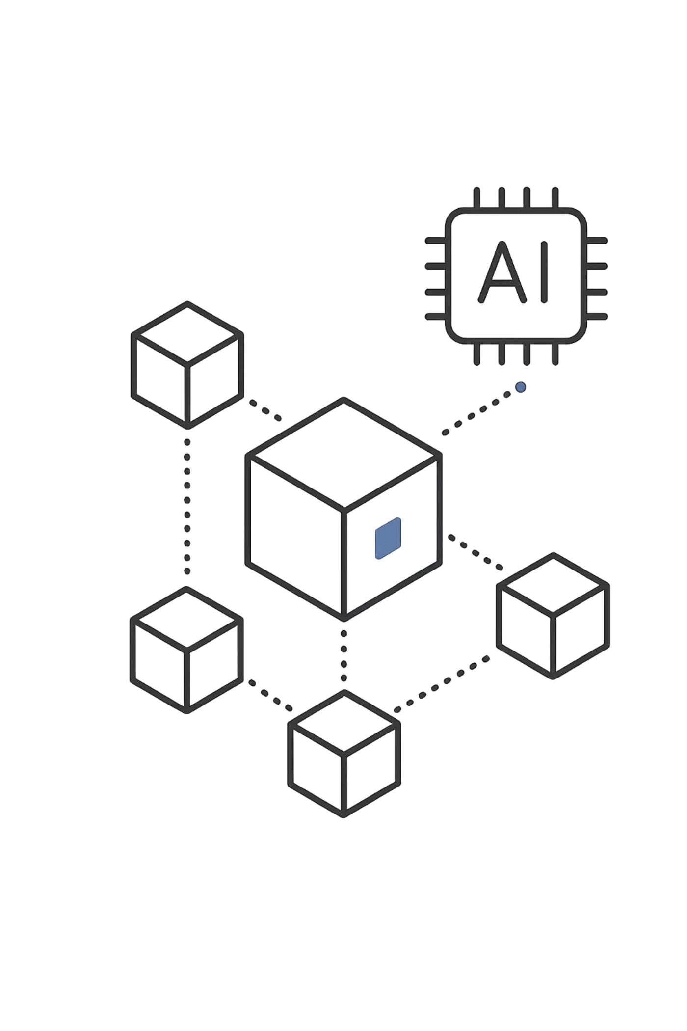
AI-Driven Content Authenticity verification and BlockChain Audit
System
Team Members:
2303A51272 - A.Srivani
2303A51923 – V.Sravani
2303A510g6 – G.Charanya
2303A51635 – S.Keerthi
2303A510h4 – T.Meghana

Slide 2

Project Overview
This innovative system addresses the critical challenge of digital content authenticity in an era of sophisticated deepfakes and misinformation. By leveraging hybrid AI models for content analysis and blockchain technology for immutable verification records, the platform provides real-time authentication capabilities.
The system processes digital content through multiple AI verification layers, generates cryptographic hashes, and stores verification results on-chain. This creates a transparent, tamper-proof audit trail accessible to all stakeholders.

Slide 3
Key Objectives
AI-Powered Analysis
Immutable Records
Deploy machine learning models to detect anomalies, identify manipulated content, and verify digital signatures with high accuracy
Store verification hashes and metadata on blockchain to ensure data integrity and prevent tampering throughout content lifecycle
Real-Time Verification
Trust Framework
Process and authenticate content within milliseconds, enabling immediate validation for time-sensitive applications and streaming platforms
Establish transparent verification protocols that build user confidence and provide verifiable proof of content authenticity

Slide 4




Target Stakeholders
Media Organizations
Platform Providers
Government Agencies
Enterprise Clients
News outlets, broadcasters, and publishers seeking to verify content authenticity before publication and maintain journalistic integrity
Social networks, content sharing platforms, and streaming services requiring automated verification for user-generated content at scale
Corporations managing digital assets, intellectual property, and marketing materials requiring proof of authenticity for legal and compliance purposes
Regulatory bodies, defense departments, and public institutions needing secure authentication for official communications and sensitive documents

Slide 5
Technology Stack
1
2
Programming Languages
AI/ML Frameworks
Python 3.9+ for AI model development
JavaScript/TypeScript for frontend development
Node.js for backend services
Go for blockchain integration
SQL for database operations
TensorFlow 2.x for neural network models
PyTorch for deep learning research
Scikit-learn for traditional ML algorithms
OpenCV for image processing
Hugging Face Transformers for NLP tasks
3
4
Blockchain Tools
Infrastructure & DevOps
Ethereum or Polygon for smart contracts
IPFS for decentralized storage
Web3.js for blockchain interaction
Hardhat for contract testing
Moralis for API integration
AWS/GCP for cloud hosting
Docker for containerization
Kubernetes for orchestration
Git/GitHub for version control
Jenkins for CI/CD pipelines

Slide 6

AI Model Generation Prompts
Prompt Design Philosophy: All prompts include explicit constraints, output format specifications, and example-based learning to ensure consistent, production-ready code generation
01
02
Image Verification Model
Audio Authentication System
"Create a convolutional neural network using TensorFlow that analyzes image metadata, detects compression artifacts, and identifies AI-generated content. Include data preprocessing pipeline, model architecture with dropout layers, and evaluation metrics. Output Keras model code with comments."
"Develop a deep learning model that processes audio waveforms to detect synthetic voices and voice cloning. Use LSTM networks with attention mechanisms. Include feature extraction functions for MFCC coefficients and spectral analysis. Provide training loop with validation."
03
04
Video Analysis Pipeline
NLP Content Authenticator
"Build a video processing system that extracts frames, analyzes temporal consistency, and detects deepfake artifacts. Implement using PyTorch with 3D CNN architecture. Include frame sampling logic, motion analysis, and lip-sync verification modules."
"Create a transformer-based model using BERT architecture that identifies AI-generated text patterns and writing styles. Include fine-tuning procedure with labeled dataset, text preprocessing functions, and confidence scoring mechanism."

Slide 7
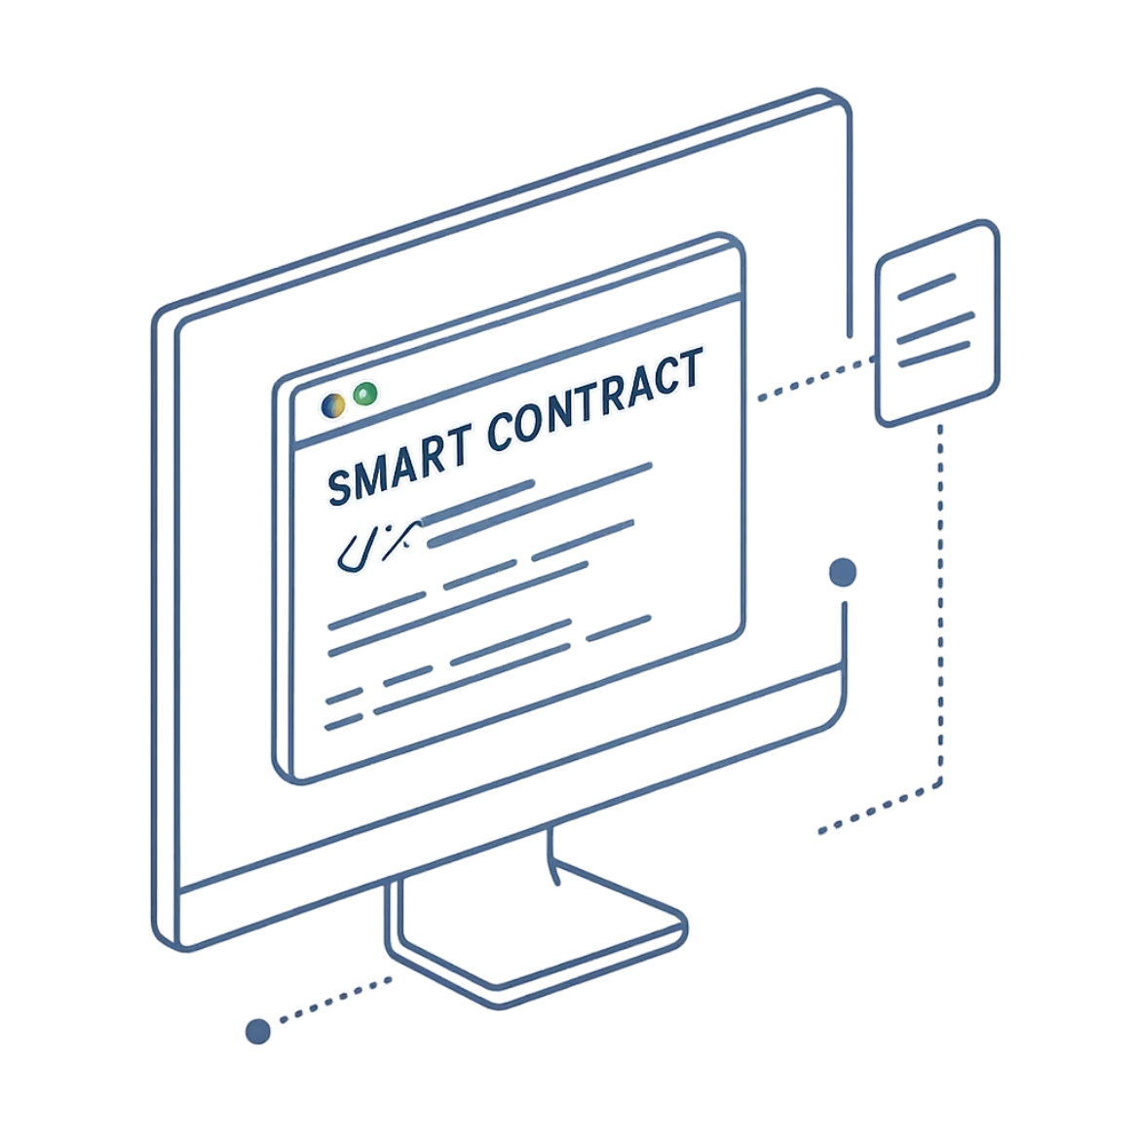
Blockchain Integration Prompts
Smart Contract Development
"Write a Solidity smart contract for Ethereum that stores content hashes with verification timestamps and content metadata. Include functions for hash registration, retrieval by content ID, and verification status queries. Implement access control modifiers and event emitters for state changes."
IPFS Integration
"Create Node.js functions that upload content metadata to IPFS decentralized storage and return content identifiers. Include error handling for network failures, content pinning logic, and metadata schema validation."
Web3 Interface
"Develop JavaScript client using Web3.js library that connects to Ethereum node, signs transactions with user wallets, and interacts with verification smart contract. Include connection pooling and rate limiting."

Slide 8
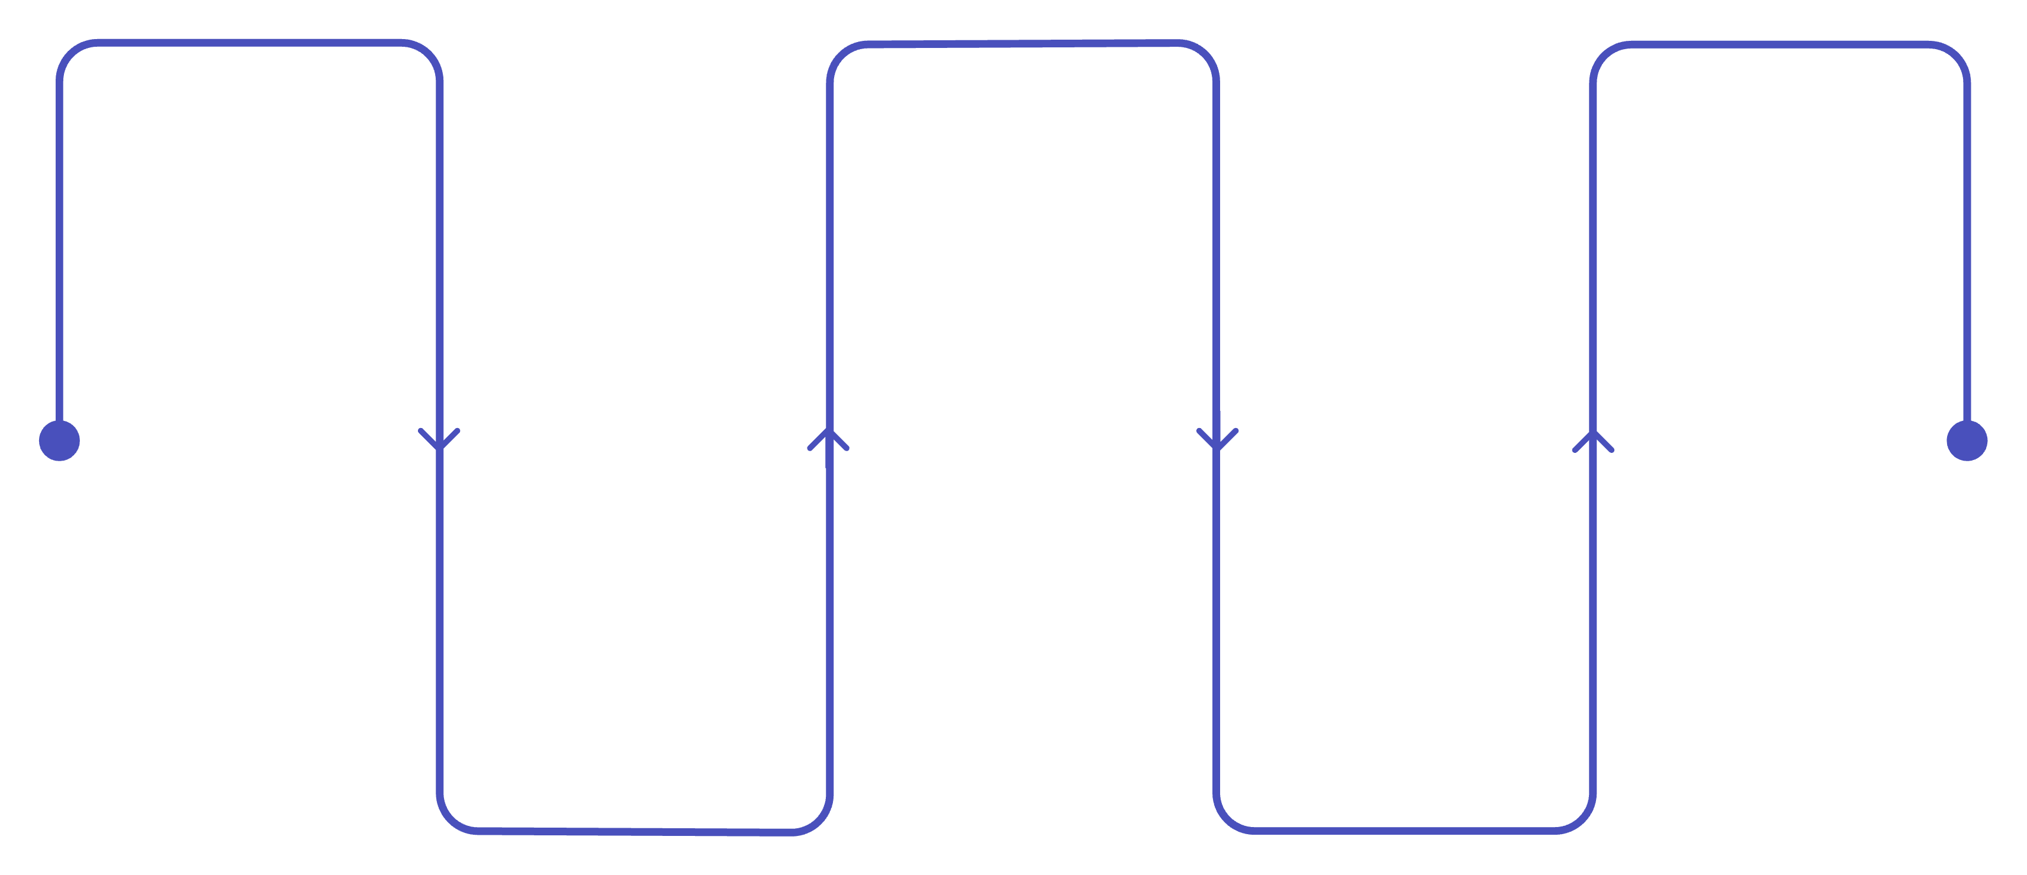
System Workflow Architecture
Content Upload
Hash Generation
Verification Result
User submits file for processing
Create cryptographic signature
Return authenticated status
Blockchain Storage
AI Processing
Multiple analysis modules run
Save record to distributed ledger

Slide 9
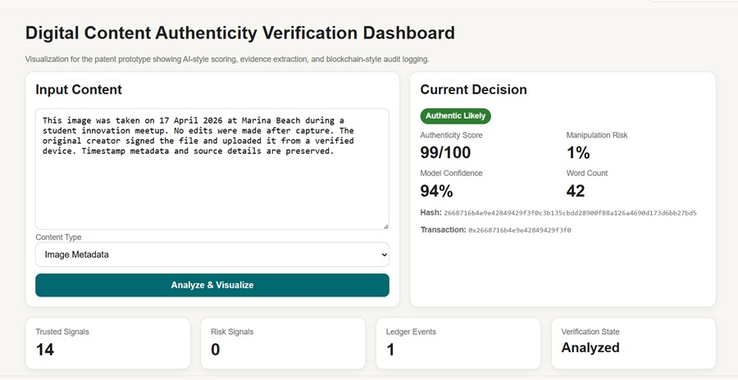
Front-End Interface Design

Slide 10
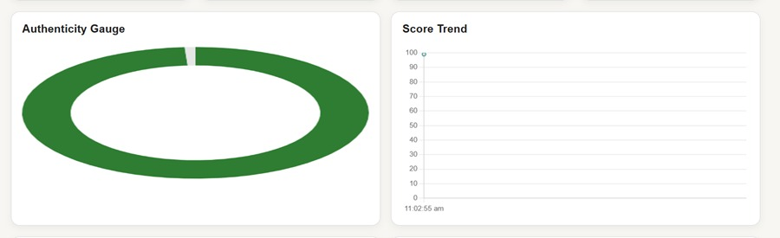
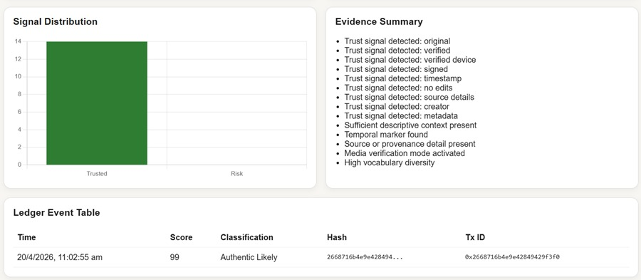

Slide 11
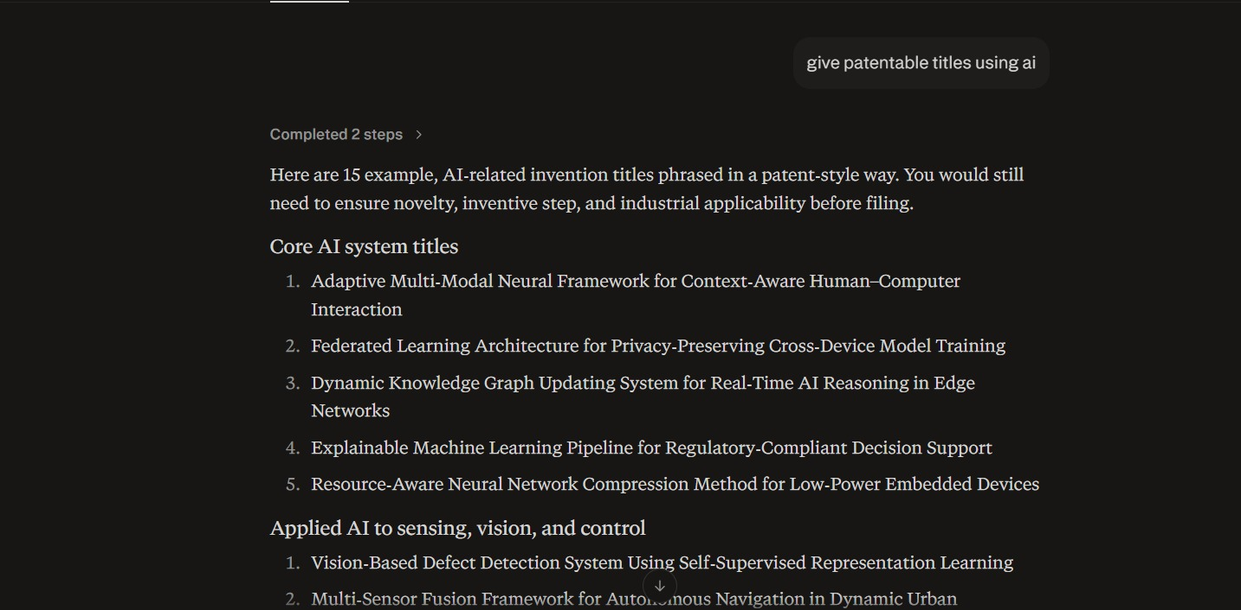
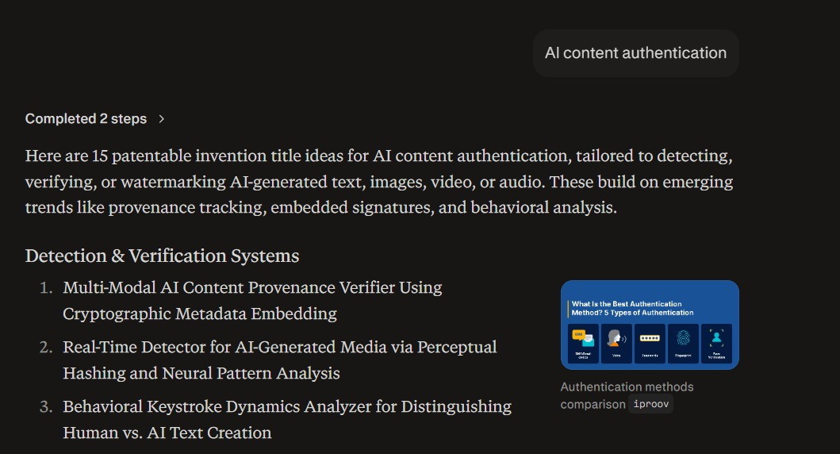
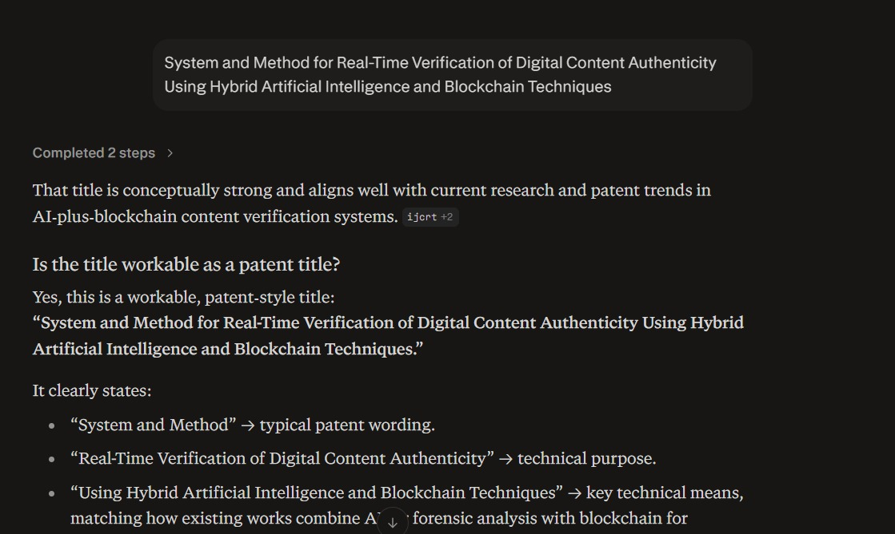
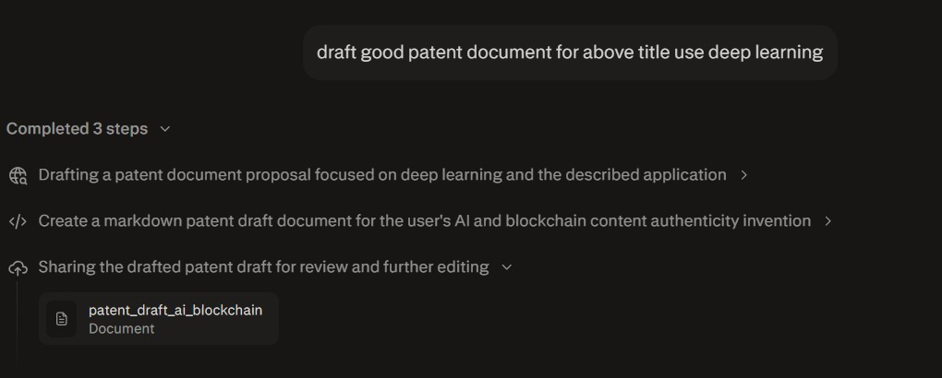
Proof of the Prompts Generating Codes

Slide 12
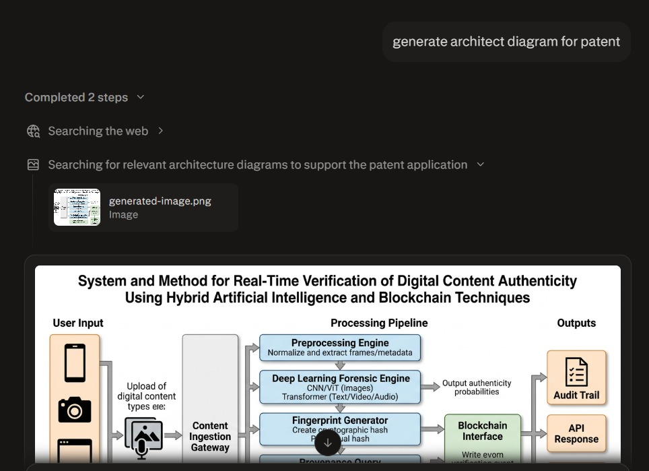
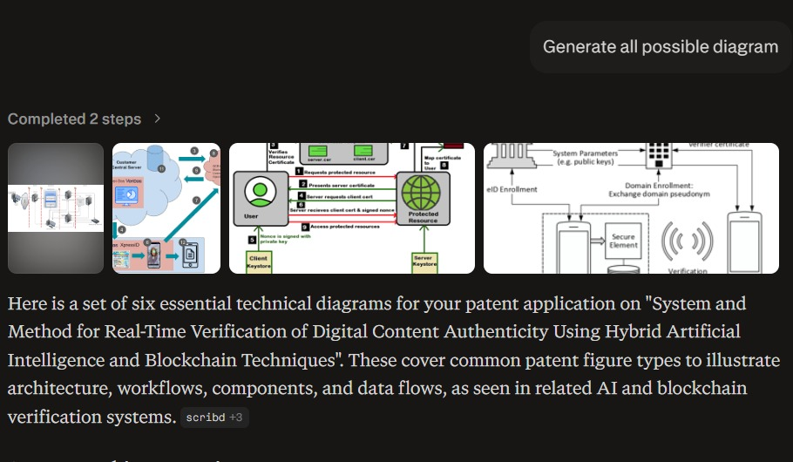
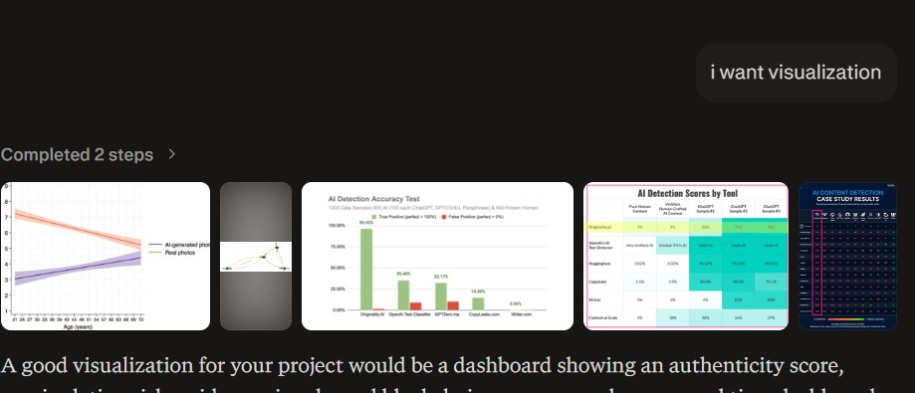

Slide 13
References & Resources
Research Papers
Technical Documentation
Open Source Projects
"Deep Learning for Digital Image Forensics" - IEEE Transactions, 2023
"Blockchain-Based Content Authentication" - ACM Computing Surveys, 2022
"Detecting AI-Generated Content" - Nature Machine Intelligence, 2024
Ethereum Yellow Paper - ethereum.org
TensorFlow Developer Guide - tensorflow.org
Web3.js Documentation - web3js.readthedocs.io
Deepfake Detection Challenge GitHub Repository
IPFS Documentation and Tools
OpenAI CLIP Model Implementation

Slide 14
Thank you

